Slide 1

EquiBank
VOICE ASSISTED BANKING SYSTEM
Daniel Bernadaz
Jc Lopez
Martin Pabellon
July 2024

Slide 2

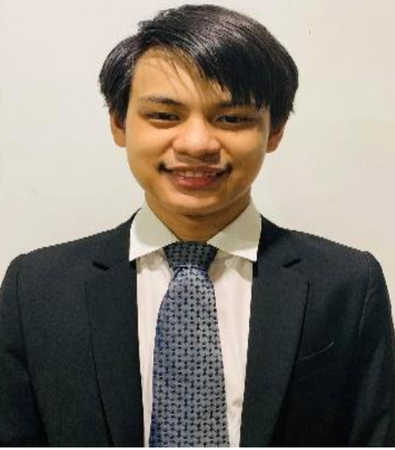
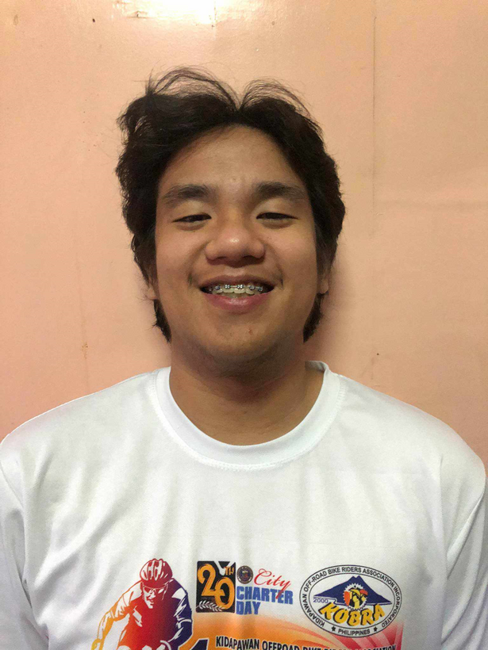


MEET THE TEAM
Founder & CEO
Founder & CEO
Founder & CEO
Daniel Bernadaz
Martin Pabellon
Jc Lopez

Slide 3
THE ISSUE
In our society today we have the luxury of accessing different commodities in the palm of our hand. Communication, Food delivery, banking etc. That is why it is at its most important that everyone should have access to this luxury. However, one of the people who cannot have this access is those who are disabled and; For our product, we focused on those who are visually impaired

Slide 4


WHAT IS EQUIBANK?
EquiBank is a voice assisted banking system mainly for the visually impaired and other disabled person to be able to use as a way to access or do banking transactions with the use of their voice.

Slide 5
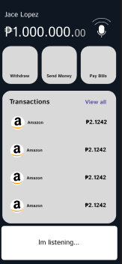
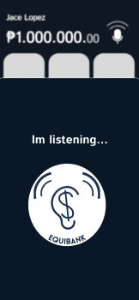
WHAT DOES EQUIBANK DO?
Voice recognition
Text-to-Speech Feedback
Check Balance
Transferring funds
Pay bills
All using voice commands

Slide 6
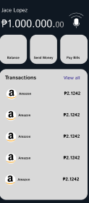
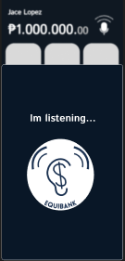

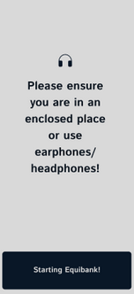
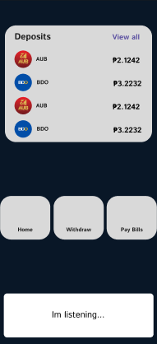
HOW DOES EQUIBANK WORK?
Start!
What to do?
Wait!
Results
Goodbye!
Q1
Q2
Q3
Q4
Q1
Users can start the system by saying “Start EquiBank”. Where it signify the start of the system with the logo and landing page
Next, users can say voice commands such as “pay bills,” “Check Balance,” “Send money”. The system will then respond to the request. In this case it is the check balance command
In order to make sure they are secure, the system will request them to be in a spot where no one else can hear them and the system or preferably to let the user wear earphones
Now that the user confirms that they are in a safe and secure location or wearing headphones the system will now display their details
The user, satisfied, will then close the system with “Close EquiBank”

Slide 7
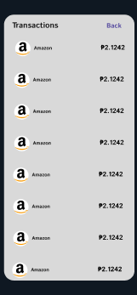
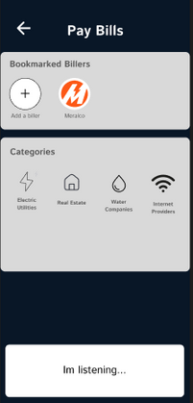
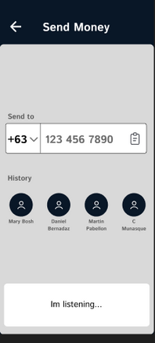
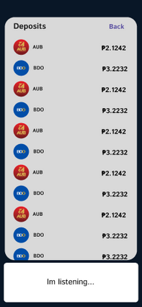

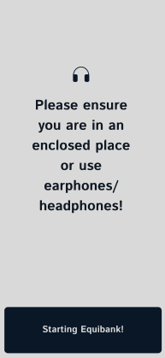
OVERALL DESIGN
Startup
Landing Screen
Landing Screen 2
All Transactions
It’s Listening
Pay Bills
Enter Number
Balance Page
All Deposits
Security Warning
Security Warning 2

Slide 8
PROS VS CONS
Accessible to the visually impaired
Easy to learn and use
Portable via handheld device
Security and privacy
Needs a working microphone and internet connection
Background noise may hinder voice recognition
Limited functionality
Security

Slide 9
THE FIVE GUIDE QUESTIONS
Motivation - what problem are you addressing?
Top requirements - what did you learn from users?
Design - what does your solution look like?
Evaluation - what did you do and what were the results?
Conclusions - if you had more time, what would you do next?

Slide 10
RESULTS AND EVALUATION
A. Visibility of System Status | 8
B. Match Between the system and the Real World | 4
C. User control and freedom | 5
D. Consistency and Standards | 10
E. Error Prevention | 8
F. Help users recognize, diagnose and recover from errors | 4
G. Recognition rather than recall | 4
H. Flexibility and efficiency of use | 5

Slide 11
RESULTS AND EVALUATION
I. Aesthetic and minimalist design | 4
J. Help and Documentation | 3
Average | 3.93

Slide 12
Thank you!
EQUIBANK : VOICE ASSISTED BANKING SYSTEM
Daniel Bernadaz
Jc Lopez
Martin Pabellon
July 2024

